Slide 1
Amortized optimization for computing optimal transport maps
Brandon Amos • Meta AI (FAIR) NYC
http://github.com/bamos/presentations

Slide 2
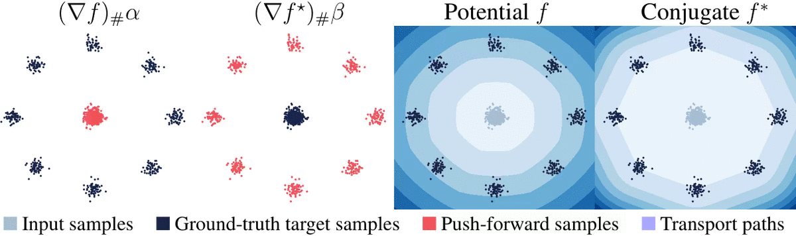
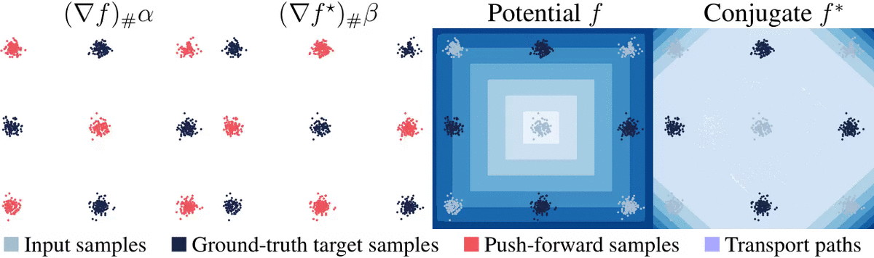
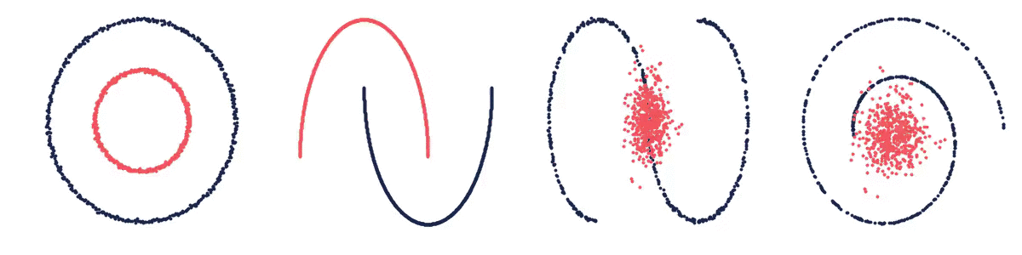

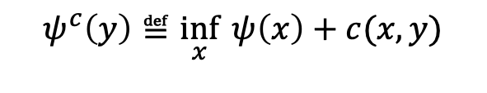
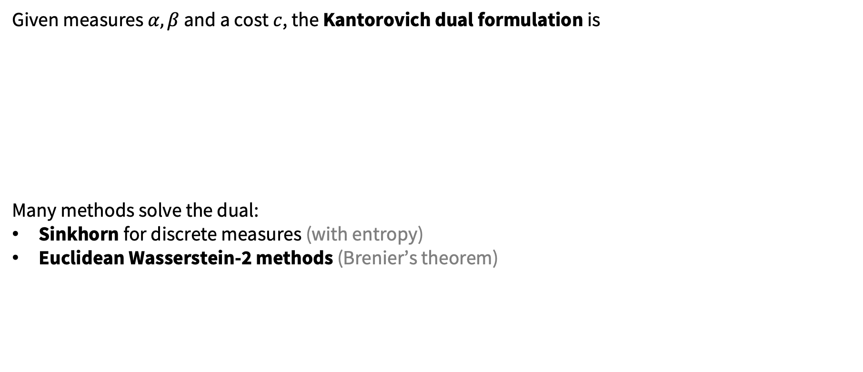
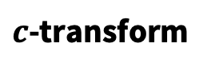
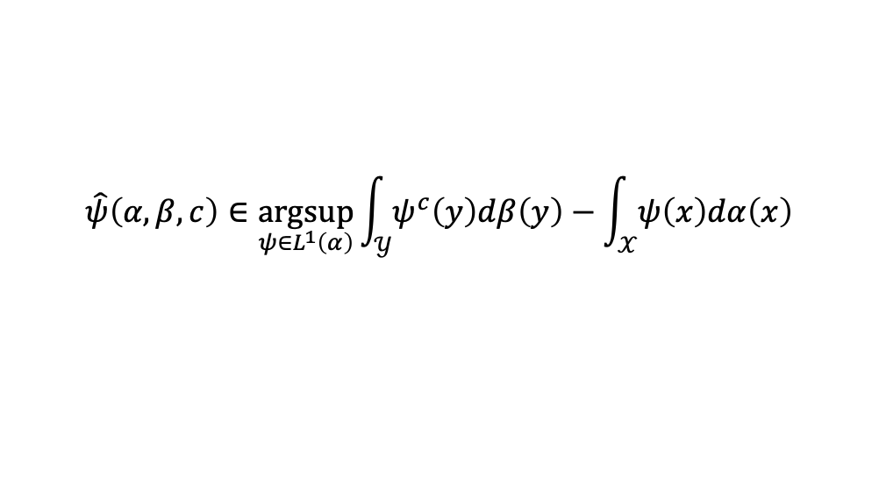
The Kantorovich dual for optimal transport
Chapter 5 of Optimal transport: old and new, Villani.
Given measures $α,β$ and a cost $c$, the Kantorovich dual formulation is
Many methods solve the dual:
Sinkhorn for discrete measures (with entropy)
Euclidean Wasserstein-2 methods (Brenier’s theorem)
$$\hat{ψ}\left(α, β, c\right)∈\underset{ψ∈L^{1}\left(α\right)}{argsup}{\int_{𝒴}{ψ^{c}\left(y\right)dβ\left(y\right)}−\int_{𝒳}{ψ\left(x\right)dα\left(x\right)}}$$
$c$-transform
where
$$ψ^{c}\left(y\right)≝\inf_{x}{ ψ\left(x\right)+c(x,y)}$$
Meta Optimal Transport. Amos et al., 2022
On amortizing convex conjugates for optimal transport. Amos, 2022

Slide 3
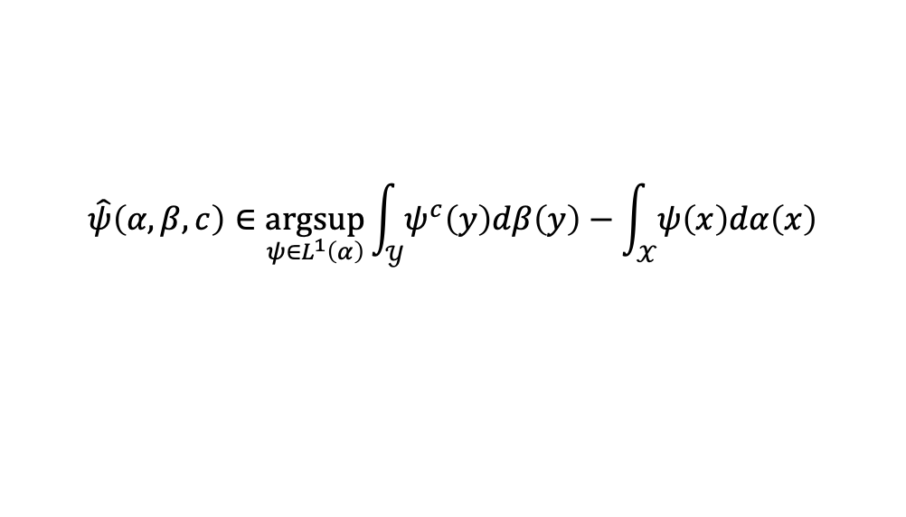
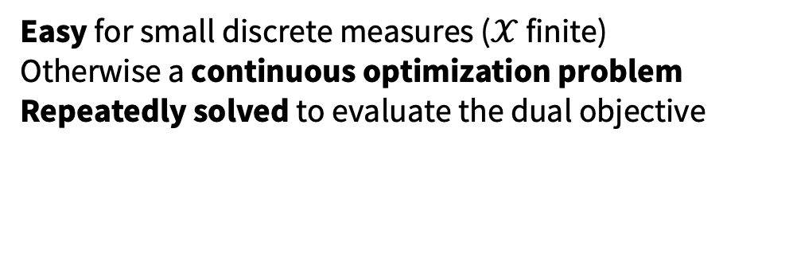
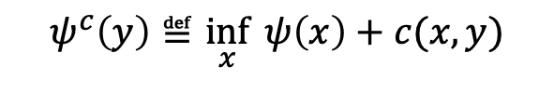
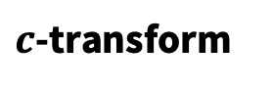
Both optimization problems may be hard
Kantorovich dual
$c$-transform
$$\hat{ψ}\left(α, β, c\right)∈\underset{ψ∈L^{1}\left(α\right)}{argsup}{\int_{𝒴}{ψ^{c}\left(y\right)dβ\left(y\right)}−\int_{𝒳}{ψ\left(x\right)dα\left(x\right)}}$$
$$ψ^{c}\left(y\right)≝\inf_{x}{ ψ\left(x\right)+c(x,y)}$$
Repeatedly solved for new measures and costs
Usually solved from scratch every time
Easy for small discrete measures ($𝒳$ finite)
Otherwise a continuous optimization problem
Repeatedly solved to evaluate the dual objective
Can machine learning help solve them? Yes!
Key idea of this talk: rapidly predict the solutions to these optimization problems
Leverages shared structure in the solution mapping

Slide 4
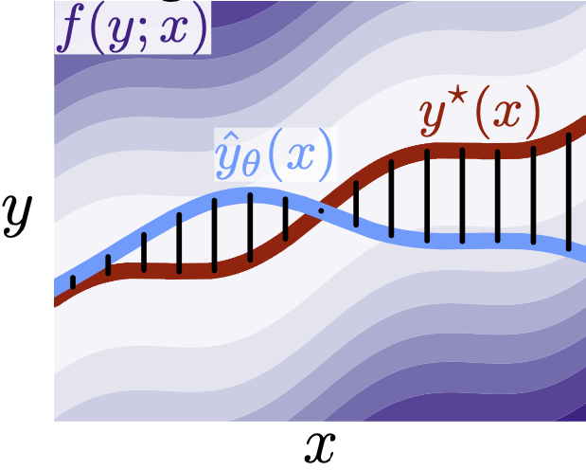
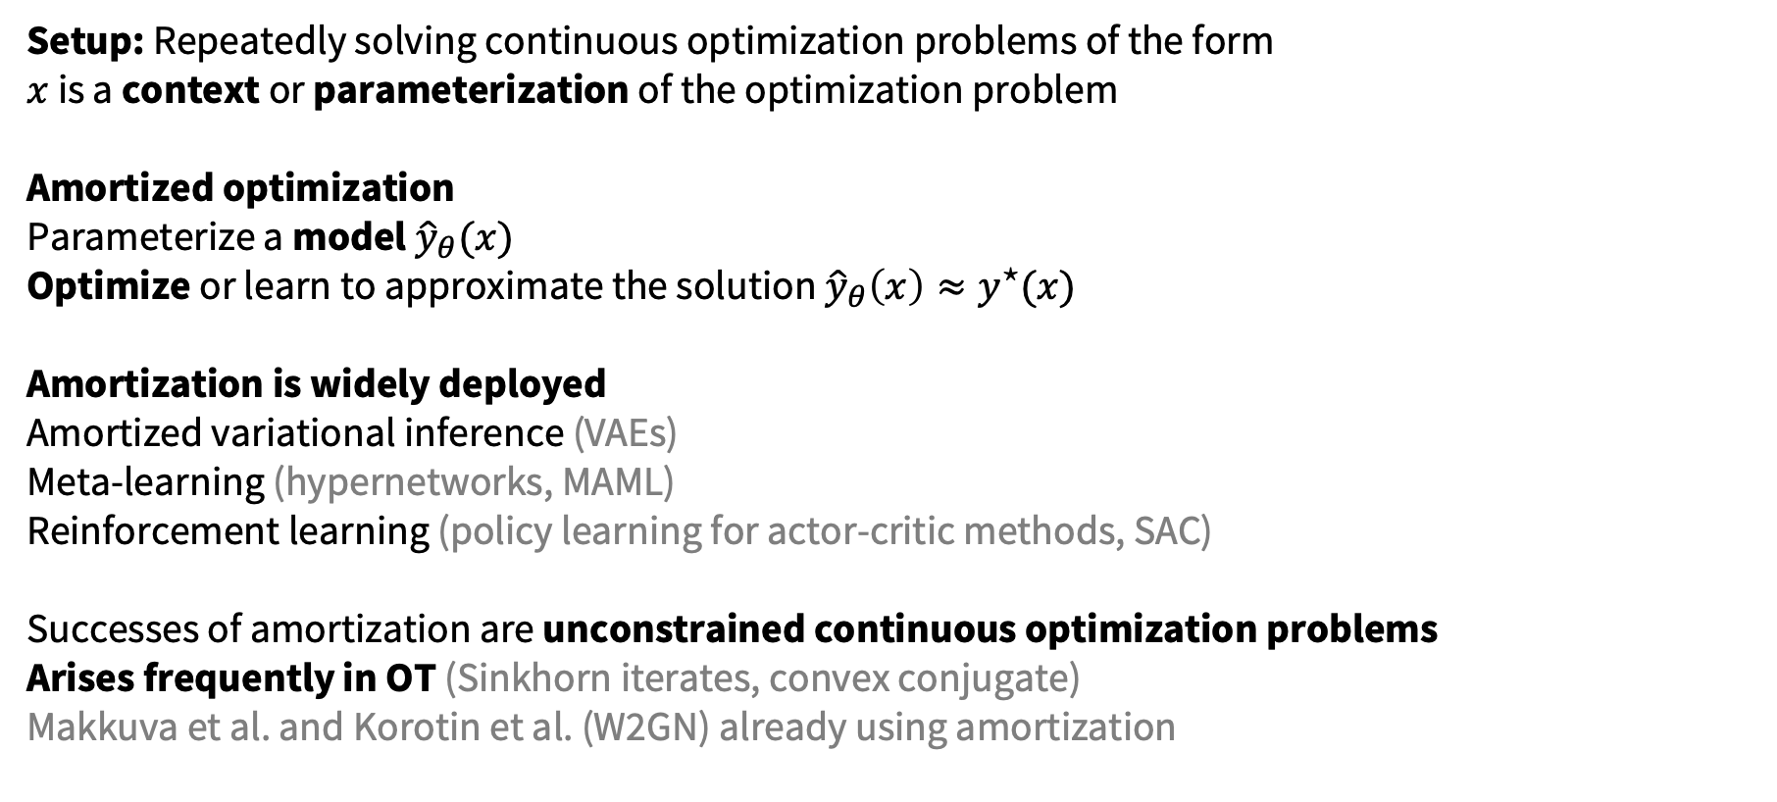

Amortized optimization
Tutorial on amortized optimization for learning to optimize over continuous domains. Amos, Foundations and Trends in Machine Learning (to appear)
Setup: Repeatedly solving continuous optimization problems of the form $x$ is a context or parameterization of the optimization problem
Amortized optimization Parameterize a model ${\hat{y}}_{θ}(x)$
Optimize or learn to approximate the solution ${\hat{y}}_{θ}\left(x\right)≈y^{⋆}(x)$
Amortization is widely deployed Amortized variational inference (VAEs) Meta-learning (hypernetworks, MAML) Reinforcement learning (policy learning for actor-critic methods, SAC) Successes of amortization are unconstrained continuous optimization problems
Arises frequently in OT (Sinkhorn iterates, convex conjugate)
Makkuva et al. and Korotin et al. (W2GN) already using amortization
$$y^{⋆}\left(x\right)∈\underset{y}{argmin}{f(y;x)}$$
Vertical slices are optimization problems

Slide 5
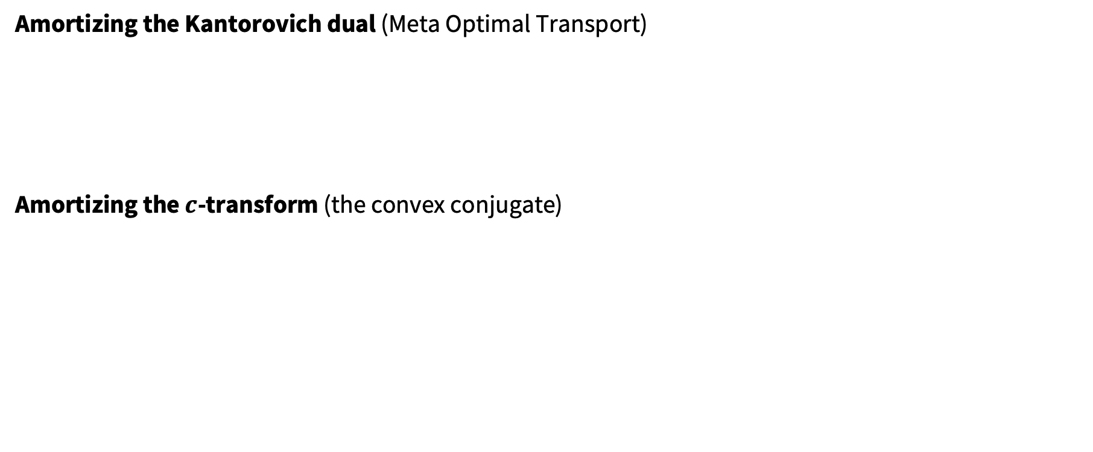
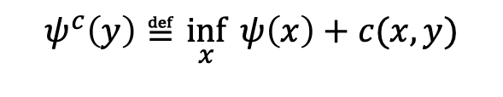
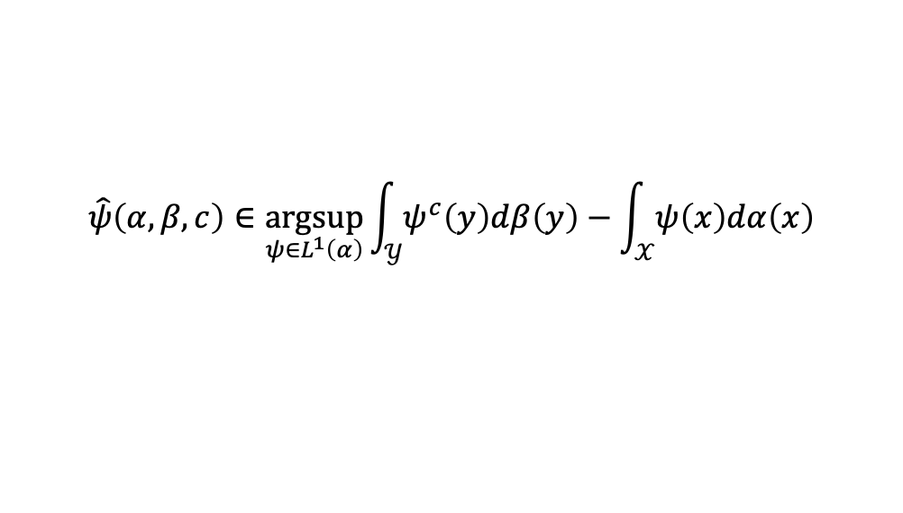

This talk: amortized optimization for OT
$$y^{⋆}\left(x\right)∈\underset{y}{argmin}{f(y;x)}$$
Amortizing the Kantorovich dual (Meta Optimal Transport)
Amortizing the $c$-transform (the convex conjugate)
$$\hat{ψ}\left(α, β, c\right)∈\underset{ψ∈L^{1}\left(α\right)}{argsup}{\int_{𝒴}{ψ^{c}\left(y\right)dβ\left(y\right)}−\int_{𝒳}{ψ\left(x\right)dα\left(x\right)}}$$
$$ψ^{c}\left(y\right)≝\inf_{x}{ ψ\left(x\right)+c(x,y)}$$
Vertical slices are optimization problems

Slide 6
Sinkhorn for entropic discrete OT
Primal formulation Dual formulation
Mapping from the dual solution to the primal
(discrete entropy)

Slide 7
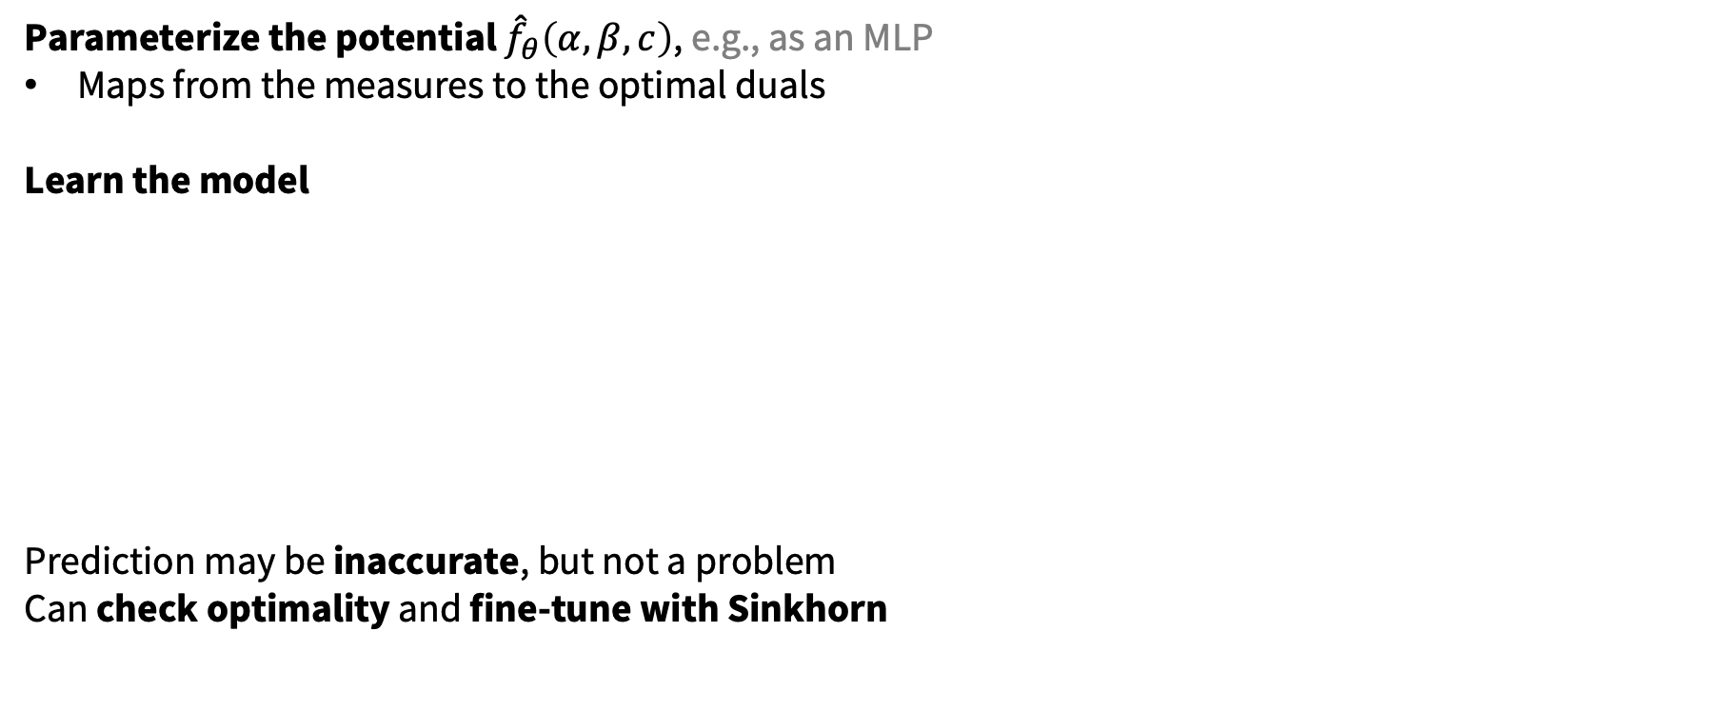
Meta OT for Sinkhorn
Parameterize the potential ${\hat{f}}_{θ}\left(α, β, c\right)$, e.g., as an MLP
Maps from the measures to the optimal duals
Learn the model
Prediction may be inaccurate, but not a problem
Can check optimality and fine-tune with Sinkhorn

Slide 8
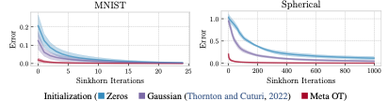
Meta OT for Sinkhorn

Slide 9
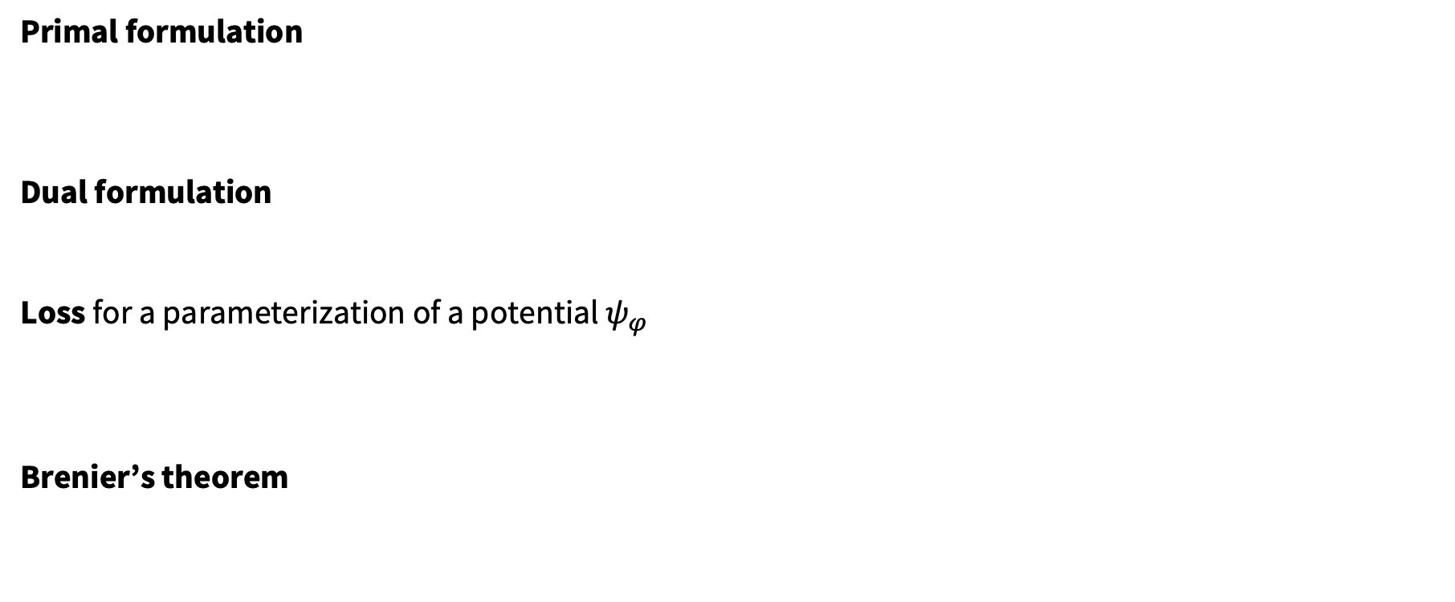
Computing Euclidean Wasserstein-2 potentials
Wasserstein-2 Generative Networks. Korotin et al., ICLR 2020.
Primal formulation
Dual formulation
Loss for a parameterization of a potential $ψ_{φ}$
Brenier’s theorem

Slide 10

Meta OT for Euclidean Wasserstein-2 potentials
Parameterize the model ${\hat{φ}}_{θ}\left(α, β\right)$, e.g., a Meta ICNN
Difference from continuous case, dual potential is a function
Hyper-network mapping from the measures to the optimal dual parameters
Learn the model with a meta version of the W2GN loss

Slide 11
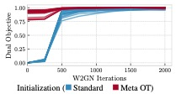
Continuous OT with Meta ICNNs

Slide 12
More Meta OT color transfer predictions

Slide 13
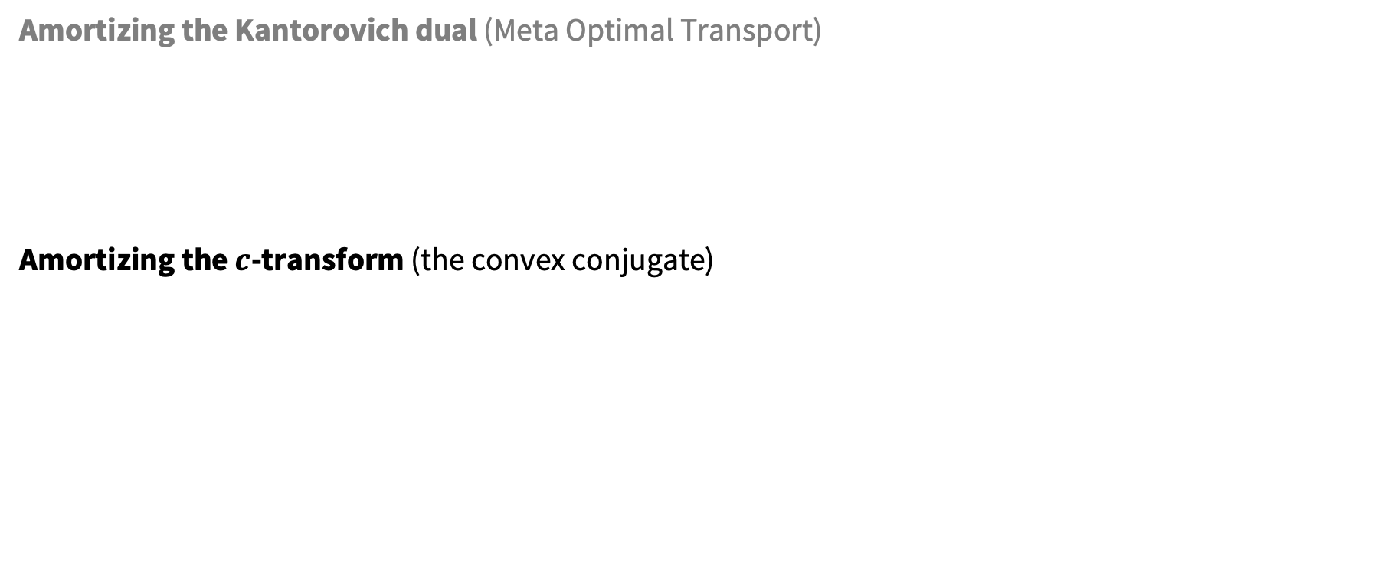
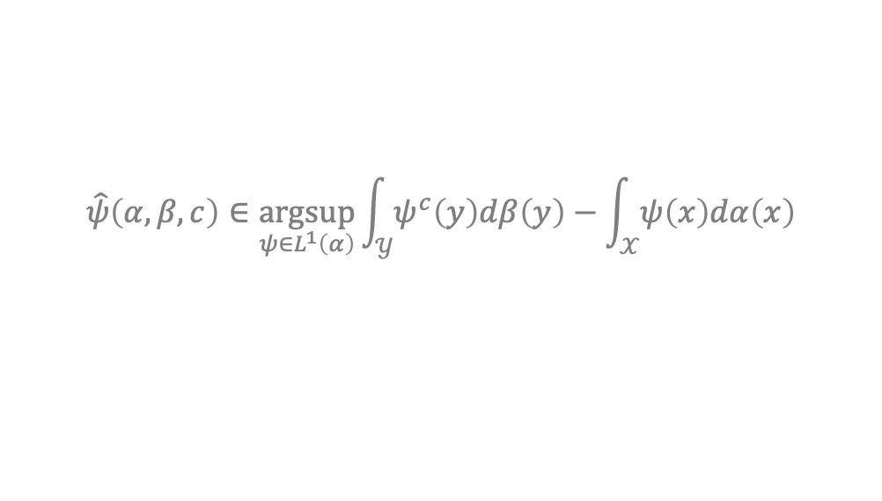
This talk: amortized optimization for OT
$$y^{⋆}\left(x\right)∈\underset{y}{argmin}{f(y;x)}$$
Amortizing the Kantorovich dual (Meta Optimal Transport)
Amortizing the $c$-transform (the convex conjugate)
$$\hat{ψ}\left(α, β, c\right)∈\underset{ψ∈L^{1}\left(α\right)}{argsup}{\int_{𝒴}{ψ^{c}\left(y\right)dβ\left(y\right)}−\int_{𝒳}{ψ\left(x\right)dα\left(x\right)}}$$
$$ψ^{c}\left(y\right)≝\inf_{x}{ ψ\left(x\right)+c(x,y)}$$
Vertical slices are optimization problems

Slide 14
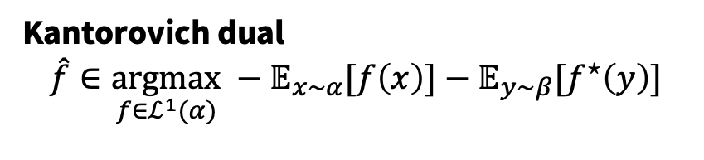
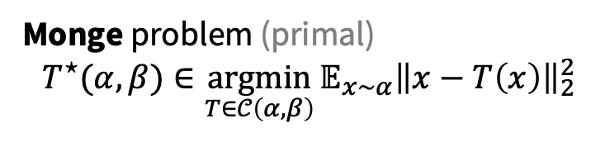
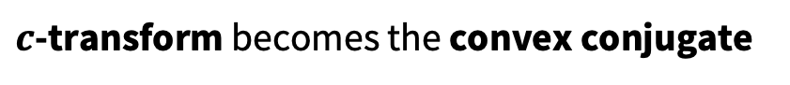
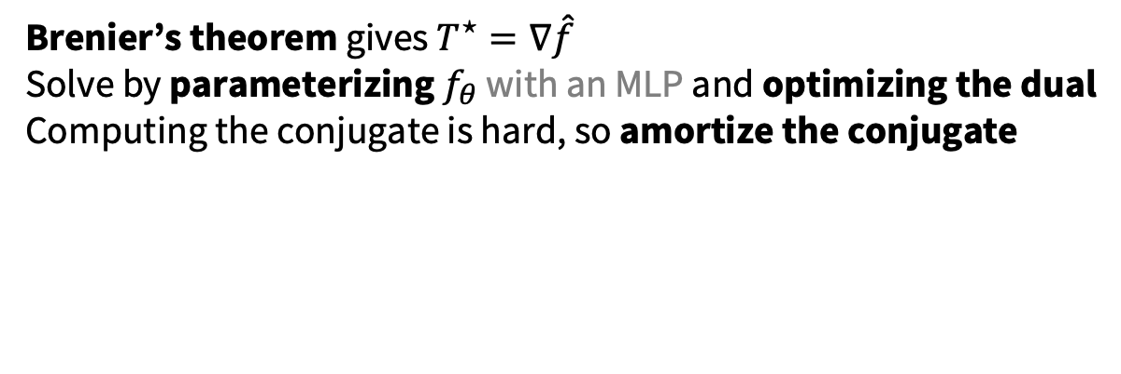
Solving Euclidean Wasserstein-2 problems
Kantorovich dual
$$\hat{f}∈\underset{f∈ℒ^{1}(α)}{argmax} −𝔼_{x∼α}[f\left(x\right)]−𝔼_{y∼β}[f^{⋆}\left(y\right)]$$
Monge problem (primal)
$${T^{⋆}(α, β)∈\underset{T∈𝒞\left(α, β\right)}{argmin}{𝔼_{x∼α}\left\|x−T\left(x\right)\right\|}}_{2}^{2}$$
$c$-transform becomes the convex conjugate
Brenier’s theorem gives $T^{⋆}=∇\hat{f}$
Solve by parameterizing $f_{θ}$ with an MLP and optimizing the dual
Computing the conjugate is hard, so amortize the conjugate

Slide 15
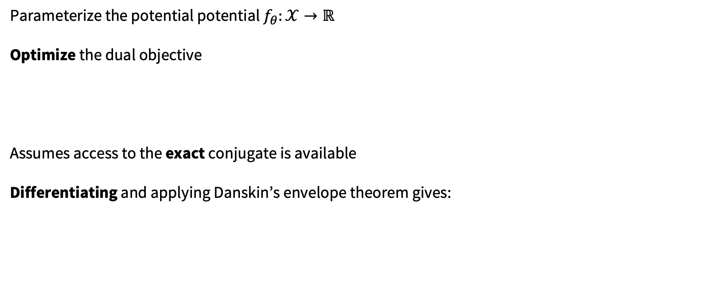
Learning the dual potentials
2-wasserstein approximation via restricted convex potentials with application to improved training for GANs. Taghvaei and Jalali, 2019.
Parameterize the potential potential $f_{θ}:𝒳→ℝ$
Optimize the dual objective
Assumes access to the exact conjugate is available
Differentiating and applying Danskin’s envelope theorem gives:

Slide 16
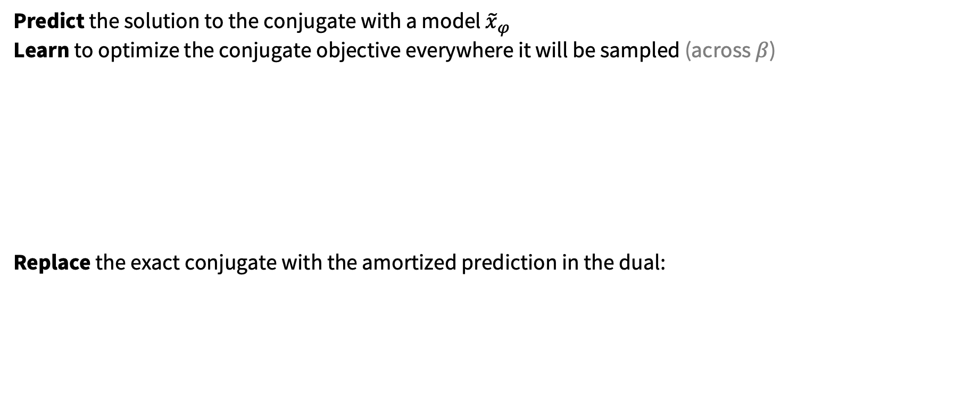
Objective-based amortization of the conjugate
Three-Player Wasserstein GAN via Amortised Duality. Nhan Dam et al., IJCAI 2019.
Optimal transport mapping via input convex neural networks. Makkuva et al., ICML 2020.
Predict the solution to the conjugate with a model ${\tilde{x}}_{φ}$
Learn to optimize the conjugate objective everywhere it will be sampled (across $β$)
Replace the exact conjugate with the amortized prediction in the dual:

Slide 17
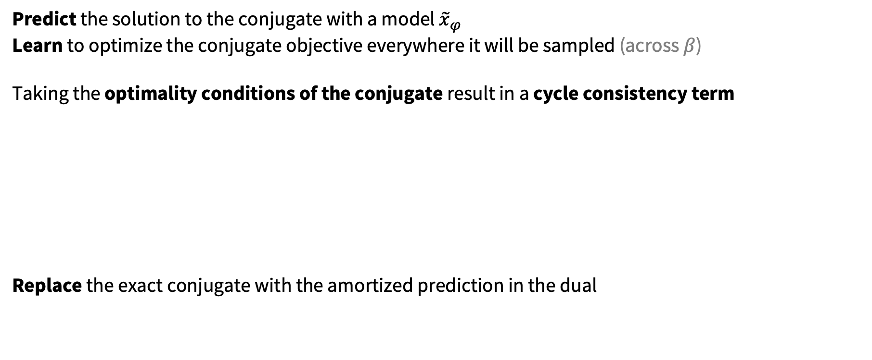
Amortizing the conjugate with cycle consistency
Wasserstein-2 generative networks. Korotin et al., ICLR 2020.
Predict the solution to the conjugate with a model ${\tilde{x}}_{φ}$
Learn to optimize the conjugate objective everywhere it will be sampled (across $β$) Taking the optimality conditions of the conjugate result in a cycle consistency term
Replace the exact conjugate with the amortized prediction in the dual

Slide 18
Fine-tuning and regression
On amortizing convex conjugates for optimal transport. Amos, 2022.
Extremely easy to fine-tune a prediction with Adam or L-BFGS Gives a much more stable estimation for the dual objective
Amortize by regressing onto the fine-tuned prediction:

Slide 19
The right amortization choices are important
On amortizing convex conjugates for optimal transport. Amos, 2022.
Results on the Wasserstein 2 benchmark (NeurIPS 2021)
Evaluation metric: unexplained variance percentage

Slide 20
Learning flows via the Kantorovich dual
Challenges for learning flows (with potentials or otherwise)
1. The model needs to be invertible
2. The likelihood of the base density is required
Optimizing the potential-based flow for the Kantorovich dual can help with both of these!
1. Often parameterize the model as a non-convex MLP, invertibility no longer matters
2. Only requires samples from the densities

Slide 21
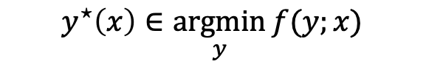
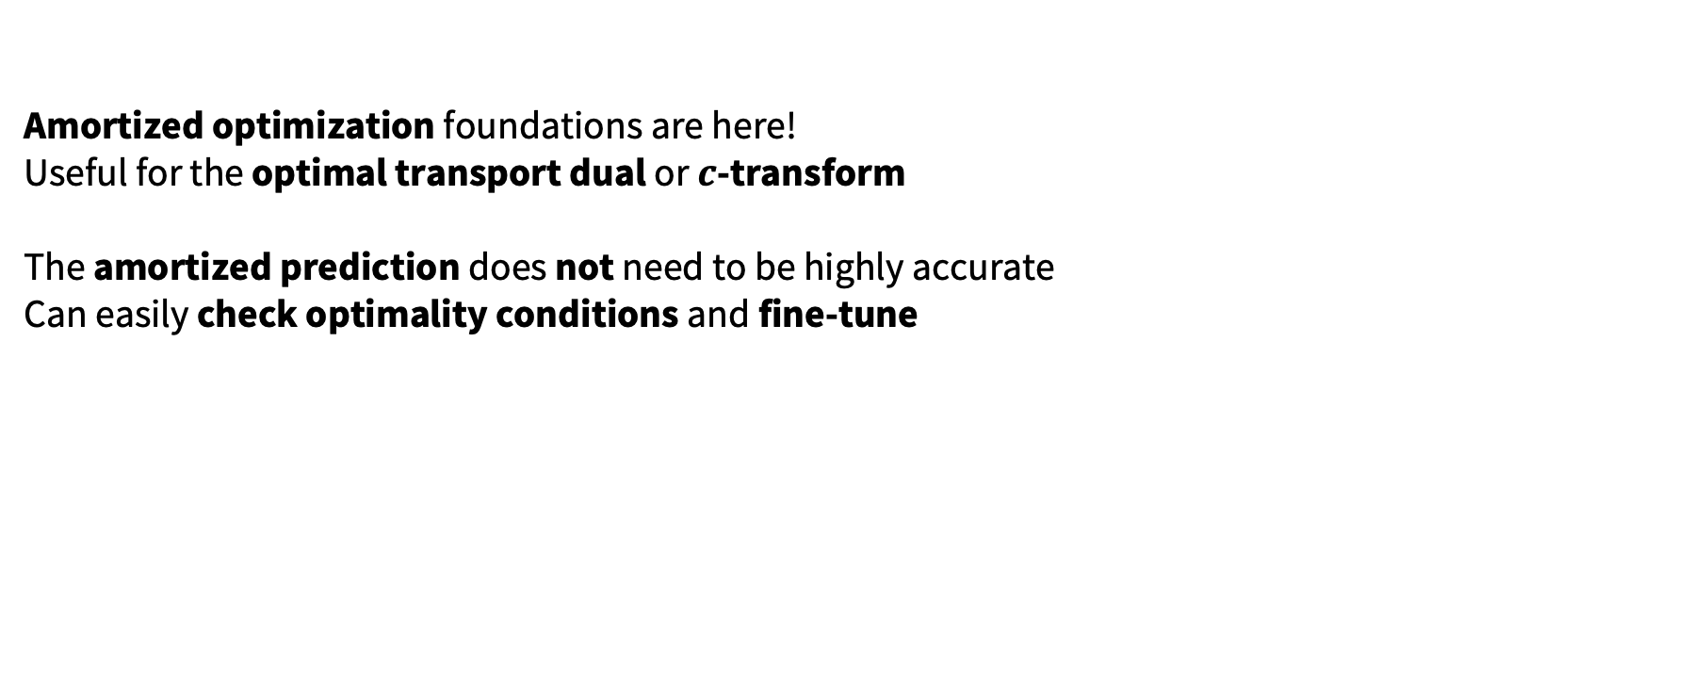
Conclusions
Amortized optimization foundations are here!
Useful for the optimal transport dual or $c$-transform
The amortized prediction does not need to be highly accurate
Can easily check optimality conditions and fine-tune
$$y^{⋆}\left(x\right)∈\underset{y}{argmin}{f(y;x)}$$
Vertical slices are optimization problems

Slide 22
Amortized optimization for computing optimal transport maps
Brandon Amos • Meta AI (FAIR) NYC
http://github.com/bamos/presentations
Tutorial on amortized optimization, Brandon Amos, Foundations and Trends in ML, to appear.
Meta Optimal Transport, Brandon Amos, Samuel Cohen, Giulia Luise, Ievgen Redko, 2022.
On amortizing convex conjugates for optimal transport, Brandon Amos, 2022.

